Slide 1


Capstone Project Phase 1
Universal Language Model Fine-Tuning
for Text Classification
Supervisors:
Dr. Renata Avros
Prof. Vladimir (Zeev) Volkovich
Group members:
Bradley Feitsvaig
Aviv Okun

Slide 2

Natural Language Processing
Subfield of linguistics and artificial intelligence.
Focuses on the interaction between computers and human language.
Speech recognition, natural language understanding, and natural language generation.

Slide 3
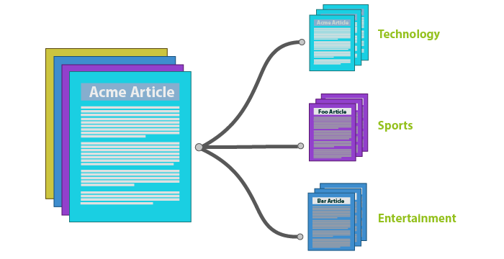
Text Classification Tasks
Sentimental analysis.
Topic classification.
Question classification.

Slide 4



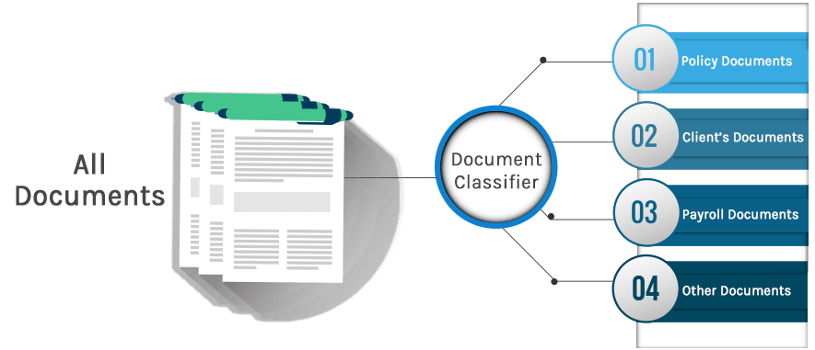
Applications
Spam detection.
Bot detection.
Fraud detection.
Commercial document classification.

Slide 5


Problem Formulation
Neural Network can usually deal with one specific NLP task.
Training neural networks from scratch requires time and resources.
There is a need for a model that can switch between tasks by fine-tuning.

Slide 6
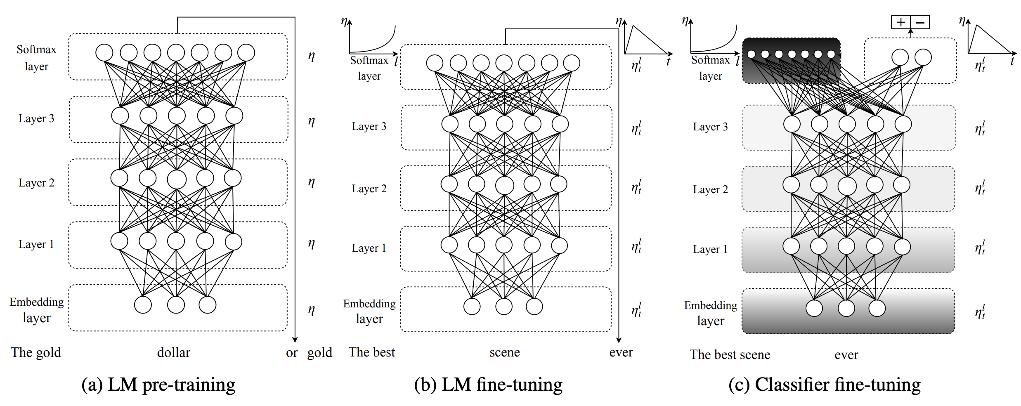
ULMFiT
An effective transfer learning method that can be applied to any task in NLP.
Introducing techniques that are key for fine-tuning a language model.
ULMFiT will be applied to English and non-English languages.

Slide 7
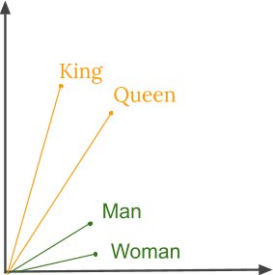
Word Embedding
Neural Networks work with numerical values.
Vectors are used to represent words.
Each word in a vocabulary is assigned a specific vector.

Slide 8

Word Embedding

Slide 9
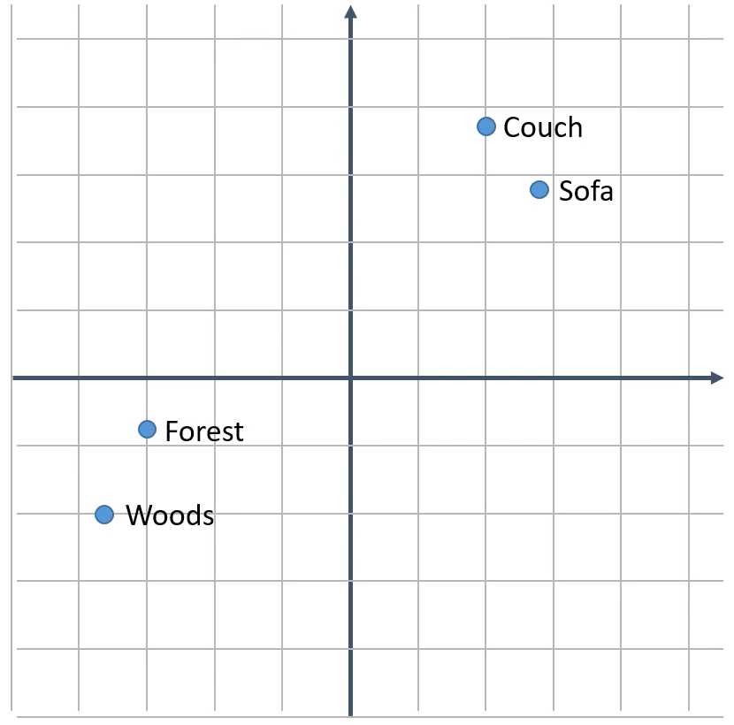
Word Embedding
Word Embeddings must preserve the relation between words.
Distance between vectors reflects word similarity.
Output
“I sat on the couch”
Neural Network
≈
“I sat on the sofa”
Output

Slide 10
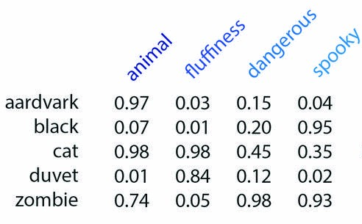
Word Embedding
“Word Embedding” = Feature Vector representation of a word.
<0.332,-1.235,0.332, … , -1.763,-1.232>
300 components

Slide 11

Bidirectional Encoder Representations from Transformers (BERT)
Transformer-based machine learning technique for NLP.
Developed by Google.
Outperform other word embeddings techniques like Word2Vec.

Slide 12
Bidirectional Encoder Representations from Transformers (BERT)
“We went to the river bank”
“I need to go to the bank to make a deposit”
Word2Vec will generate the same single vector for the word bank for both sentences. Whereas BERT will generate different vectors.

Slide 13
ULMFiT Algorithm
General domain language model pretraining
Target task language model fine tuning
Target task classifier

Slide 14
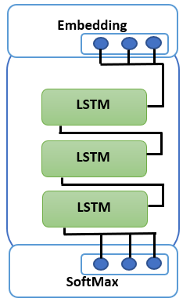
General domain language model pretraining
Pretrained on a large general domain corpus.
The most expensive part of the learning process.
Performed only once.
Model can predict the next word in a sequence.
General domain language model pretraining
Target task language model fine tuning
Target task classifier

Slide 15
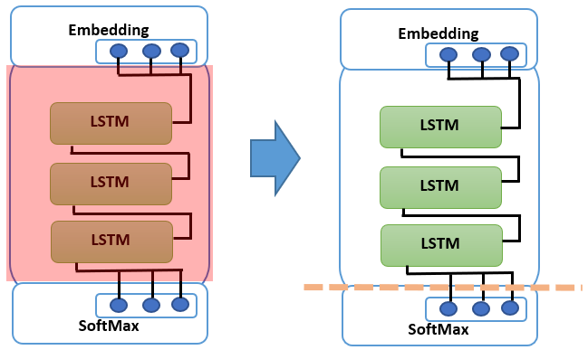
Target Task Language Model Fine Tuning
Fine tune the model on a dataset that is related to the target task.
Fine-Tuning with gradual unfreezing steps:
First “freeze” the weights of the LSTM layers.
Train the rest of the model for one epoch.
All layers unfrozen.
Train the whole model.
Discriminative Fine-Tuning. Different LRs for each layer.
LM has now learned task-specific features of the language.
The decoder and the softmax layer are cut off.
General domain language model pretraining
Target task language model fine tuning
Target task classifier

Slide 16
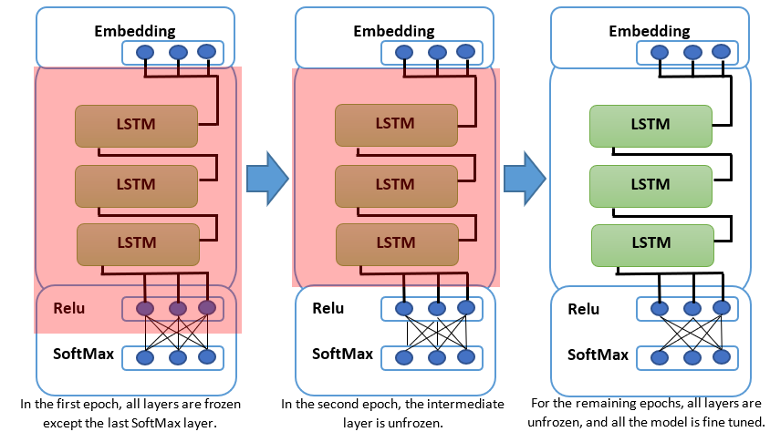
Target task classifier
Two linear blocks are added on top of the LSTM layer.
Block structure selected according to the task.
Fine-Tuning with gradual unfreezing steps:
First epoch - softmax and embedding layers trained.
Second epoch – ReLU layer fine-tuned as well.
In the remaining epochs the entire model is fine tuned.
Discriminative Fine-Tuning. Different LRs for each layer.
General domain language model pretraining
Target task language model fine tuning
Target task classifier

Slide 17
Outcomes
Research Tool
Examine the effectiveness of the ULMFiT.
2 language model.
Different NLP tasks.
Build a new language models with different components.
Use GRU instead of LSTM.
Use different embedding.
Try different training parameters.

Slide 18
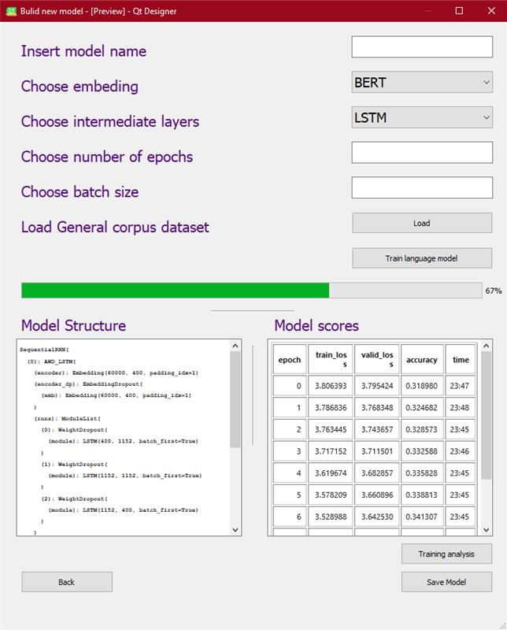
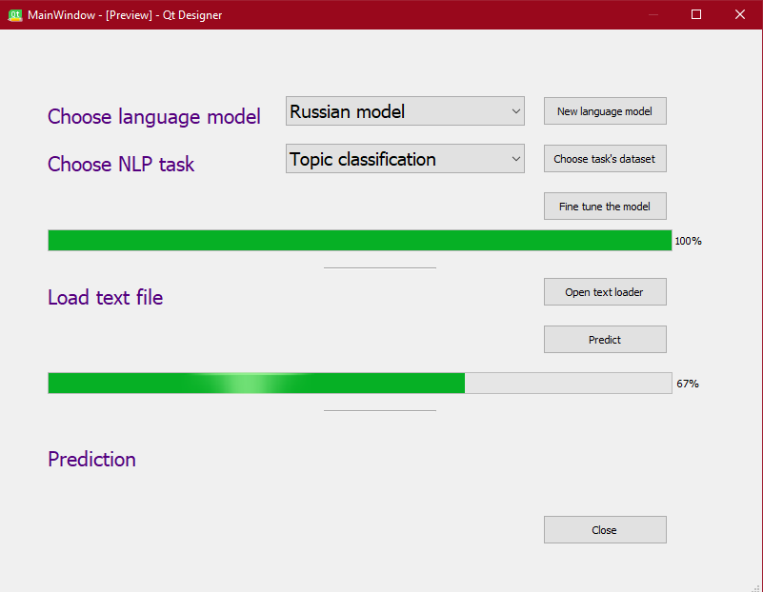
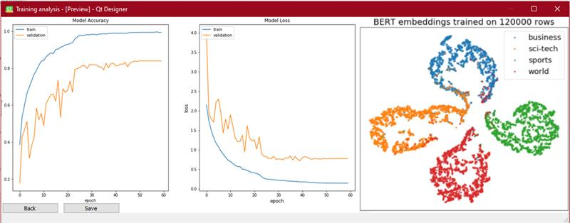
Outcomes
Application
Text classification window
Fine tuned the LM according to The NLP task.
Get prediction for a text file.
New language model window
Allows to build a new LM without engaging with the code.
Modify the LM structure and training parameters.
Training analysis window
Shows training analysis for the new LM.

Slide 19
Verification plan
Model Testing
Test if the model can transfer tasks successfully.
Testing each step of the algorithm:
General domain language model pretraining .
Target task language model fine tuning.
Target task classifier.
Test the learning process.
Test the model structure.
Use of unit test Python Library.

Slide 20
Verification plan
Graphic User Interface Testing.
GUI navigation.
Forms functionality.
Test the accuracy of the plots in the application.
Use an automated functional GUI testing.

Slide 21
Challenges
Perform the ULMFiT algorithm on different languages.
Finding dataset that will be used as a large general domain corpus
Using different components for the model structure

Slide 22

Summary
NLP Tasks overview
Problem formulation.
Word embeddings.
ULMFiT algorithm.
Outcomes.
Challenges.
Verification plan.

